Slide 1

A Step Towards sustainability CIS 515 Final Project

Slide 2
Objective
Present Status at ASU
Project Plan Overview & Execution Approach
Ecosystem & Engagements
Value of Solution & Success Metrics
Model Design & Architecture
Model Training
Bias Issues & Limitations
Model Validation & Monitoring
Outcome Action Pairing
Costing Analysis
Scope & Future Model Enhancement
Conclusion & Next Phase Tasks
CONTENTS

Slide 3
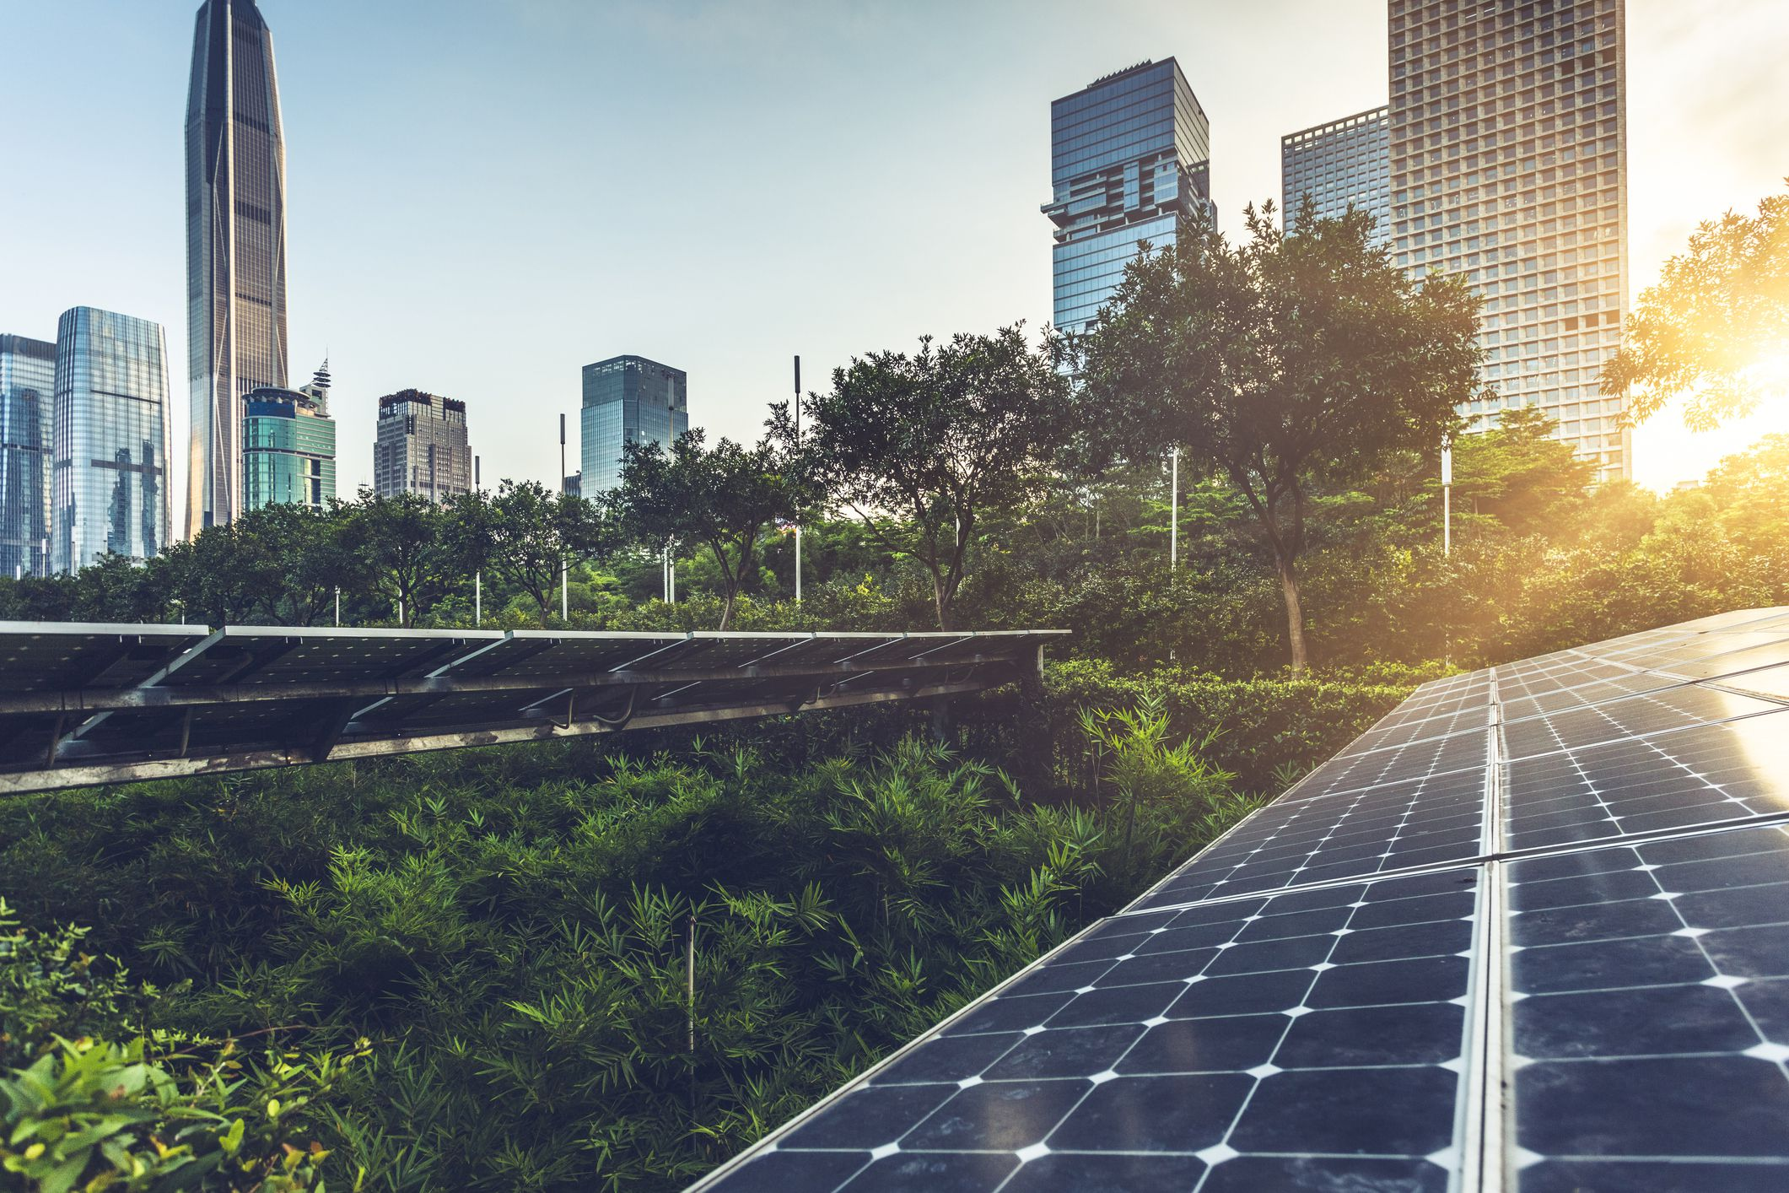
OBJECTIVE
Presenting a viable & long- term solution to achieve sustainability through waste identification & classification using “CV” technique for allotment of parking credits and subsequent solar panel production

Slide 4
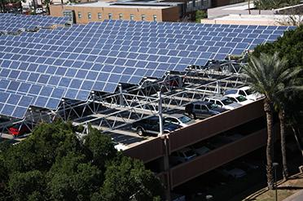
PrESENT STATUS @ ASU
Renewable Energy Generation at ASU
Solar Energy
ASU has more than 24-MWdc of photovoltaic (PV), concentrated photovoltaic (CPV) and solar thermal solar systems at 89 locations on all four of its campuses, the ASU Research Park, and off campus at the Red Rock Facility.
These include fixed, single-axis and multi-axis tracker systems located on building rooftops, parking structures, surface parking and open land. Twenty-four MWdc capacity equals nearly 50 percent of ASU's present peak daytime load.
Wind Energy
ASU has mounted six wind turbines on the roof of the Global Institute of Sustainability building to provide an additional source of renewable energy. However, these are not completing 100% of the energy needs of ASU. There is a necessity for additional methods to generate renewable energy.
ASU Parking Tariffs and Permits
Exorbitant charges are a financial burden to anyone using the parking facilities.
Parking Rates at Tempe campus
Permit options: $480-$780 (1year)
1 hour or less | 1-2 hours | 2-3hours | 3 hours and more
$4 | $8 | $12 | $16

Slide 5
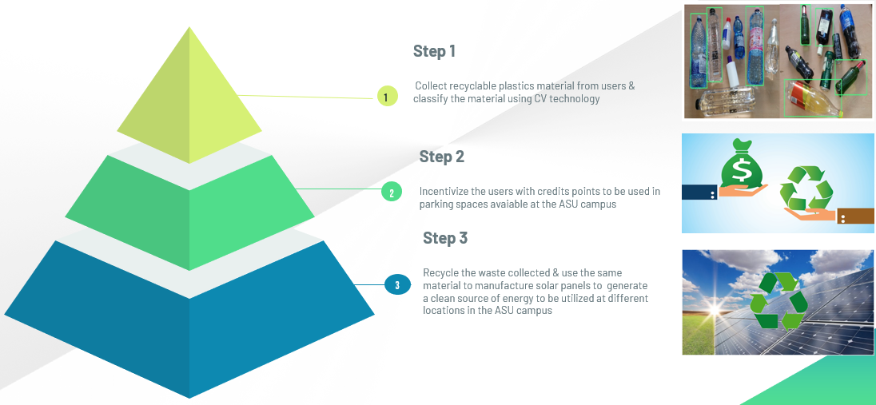
Project plan overview & Execution Approach
Data Gathering
Collecting pictures of waste materials in a Database
Prepare Data
Algorithm
Create Object Recognition CV Model
Build
Model
Recognition
Scan new images and assign credits based on match
Assigned Parking Credit
Provide user with aggregate parking credits based on number of items
Execution
Solar Panel Creation
Use recycled plastic for solar panel creation

Slide 6
ECOSYSTEM ENGAGEMENTS
KEY STAKEHOLDERS
ASU Parking Facility Team
Recycling Waste Management Team at ASU
Users from ASU community (including, staff, visitor and students)
Recycling Waste Management Vendor to recycle the plastics collected
University Technology Office
Vendor/Supplier of Solar Panels
BENEFICIARIES
ASU community
Users of parking lots at ASU
Everyone present in the ecosystem seeking a cleaner & better environment

Slide 7
Value of the SOLUTION & SUCCESS METRICS
Impact of the Program
A zest towards a cleaner and safer environment
Proposing alternative & long-term solution to reserve essential resources for the future generations
Taking advantage of deep learning technology for recycling of huge plastics waste generated and spreading awareness for cleaner solar power generation
Tackling parking problem issue at ASU with the distribution of parking credits incentives while spreading awareness & a sense of responsibility of giving back to the society
Success Metrics
Successful registration and conversion of 60-70% vehicle owners to the active users of this recycling program
Distribution of 10,000 credit points within first two months redeemable at the parking place

Slide 8
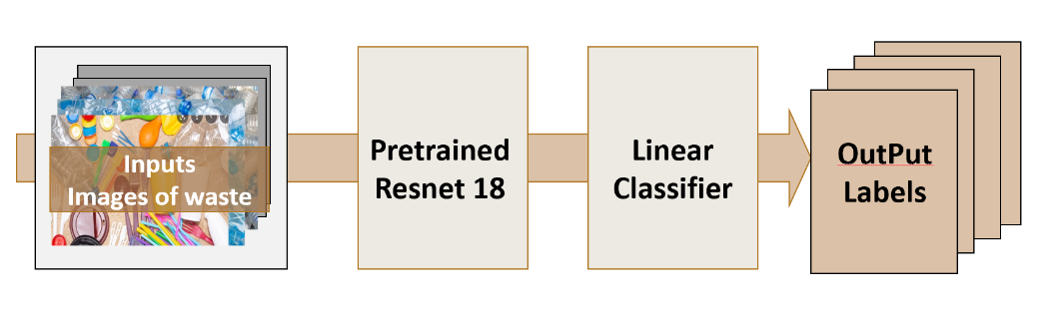
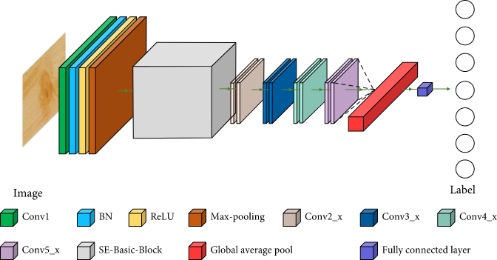
Model Design & ArCHITECTURE
Use CV for Object Detection & Image Classification
Consists of Convolutional neural networks (CNNs) with multiple hidden layers to extract high level features
Exploited transfer learning (ResNet18) to leverage knowledge from a source task & to be benefited via-
Improving baseline performance,
Speeding up overall model development and training time and
Getting overall improved model performance compared to building the model from scratch
Model Schematic
ResNet18 Model Architecture

Slide 9
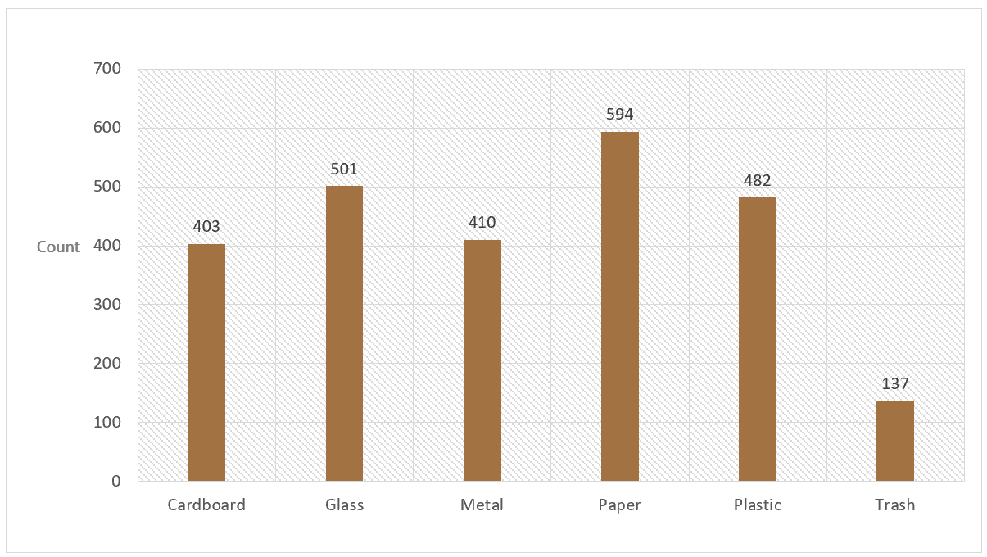
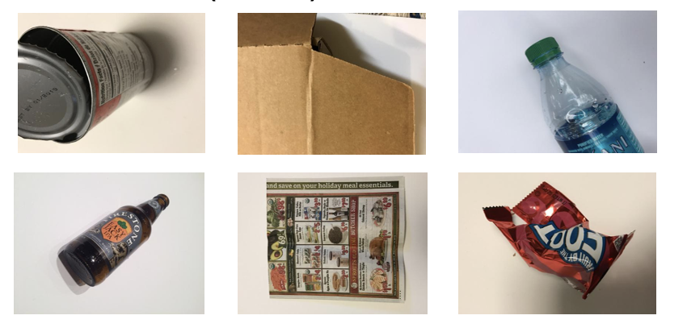
Model TRAINING
DATASET DESCRIPTION: Used TrashNet Dataset to evaluate the model
Contains multiple categories for object classification: plastic, paper, glass, metal, cardboard and miscellaneous
Also contains a range of images of waste in different orientations and positions as seen in Figure
The original dataset is 3.5GB in size, containing 2527 images in total. The number of images in each class varies with 594 paper, 501 glass, 410 metal, 482 plastic, 403 cardboard and 137 for other materials
For the evaluation, the images are split into a train, validation and test set with a 70 (1768), 15 (379), 15(380) split.
Dataset Balance & Object Classes

Slide 10
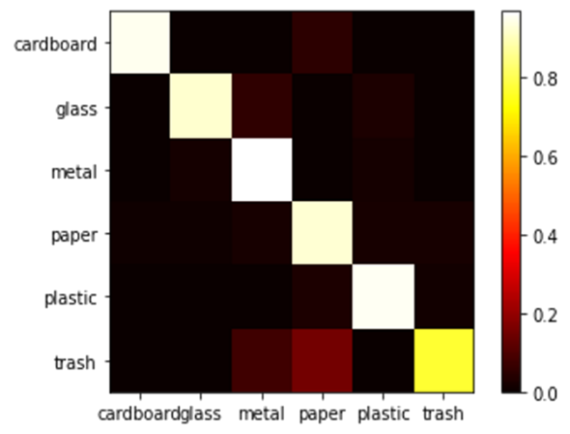
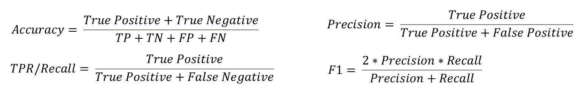
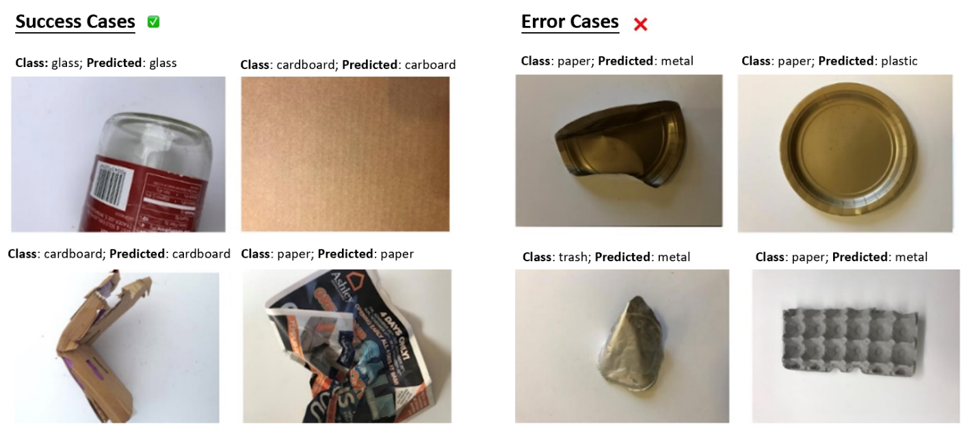
Model TRAINING
Confusion Matrix
METRICS USED: The metrics is based on the following -
Model | Accuracy | Precision | Recall | F1 Score
ResNet18 | 0.93 | 0.93 | 0.93 | 0.93
Examples of Classification Results

Slide 11
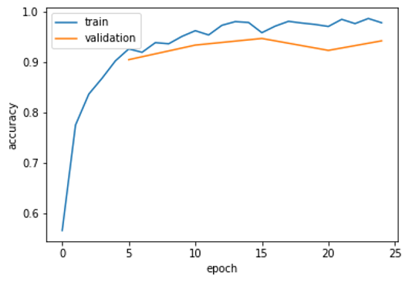
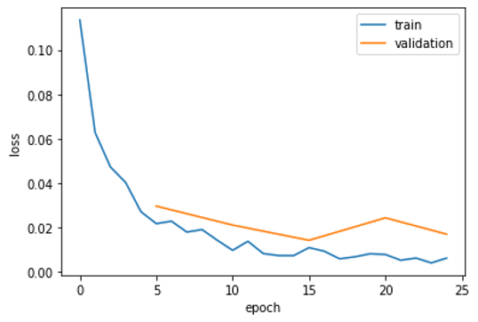
Model VALIDATION & MONITORING
MODEL ACCURACY & LOSS PLOTS
MODEL VALIDATION
Pre-Deployment: Check for any data leakage. Remove duplicates before splitting the data, check for partial duplicates as well, sort by different columns
Check for drift in historical data. Train the model on historical data and then evaluate it on current data
Post-Deployment: Calibrate the model by updating the model so that not only the final predictions are accurate, but the probability estimate is accurate as well.
Accuracy Plot
MONITORING AND UPDATE
Monitoring is important as models degrade over time, known as model drift also known as model decay, refers to the degradation of a model’s prediction power. Few Actions can be implemented to cater same:
Action 1: Retrain the model with new data
Action 2: Retrain the model with additional features
Action 3: When the negative test accuracy is significantly high, repeat the process of feature extraction, then build, and train a new model from scratch.
Loss Plot

Slide 12
Bias issues and Limitations
Issues
And
Limitation
Bias Issues
Limitation
Model evaluation: Accuracy is lost when tested on a complex background
Feature: Incorrect prediction in some cases when trash has similar features irrespective of the material (transparency, color, shape, etc.)
The model is unable to evaluate the material, let’s say, weight and density
The model does not provide real time data labels
Imbalance size for one class
Mitigation
Method
Using a bigger network i.e., more layers/nodes –both of which will increase number of model parameters
Training longer with more iterations
Using a faster/better optimization algorithm
Using a different NN architecture
Introducing more parameters to the model with additional features
Using Integrate Object-Detection networks (YOLO) for real time object labeling.
Use data augmentation or other ways to reduce class imbalance.

Slide 13
OUTCOME ACTION PAIRING
The model would provide a count of the objects scanned by the class along with some data count by the manual segregation.
To eliminate False Positives /False Negatives we plan to have data both compared and analyzed to understand the pattern in which the model classifies incorrect and then train the model further to ensure that error is reduced.
Outcome | Action
FP | Compare data from model and manual data and train model further
FN | Compare data from model and manual data and train model further
TP | Credits assigned to User
TN | Default credits assigned to user

Slide 14
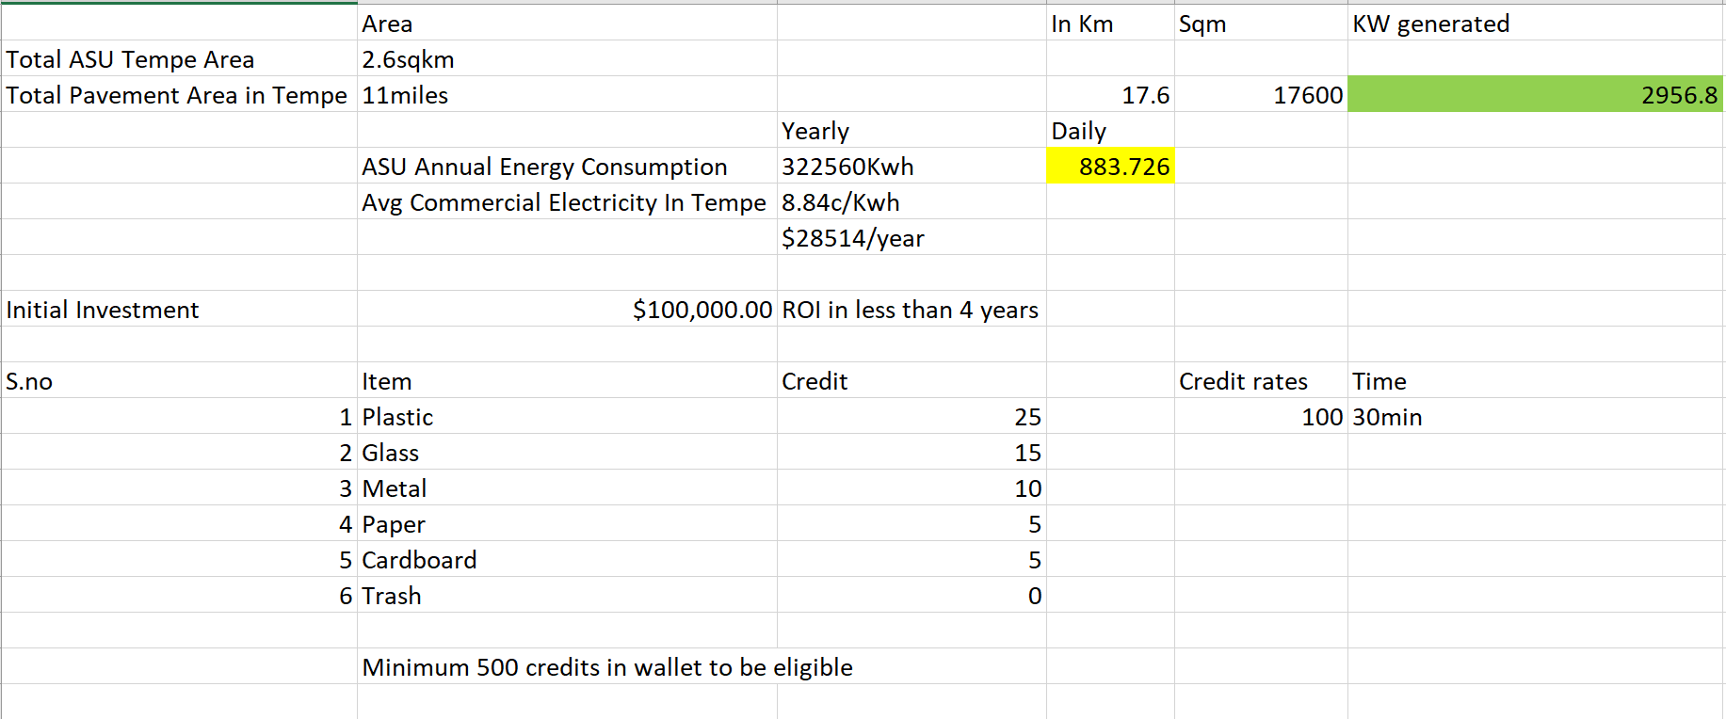
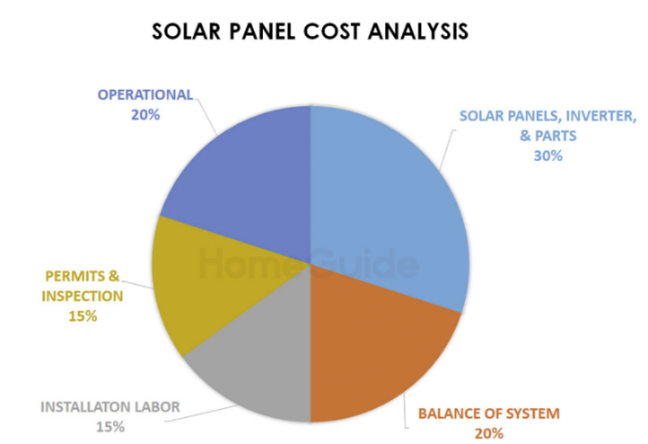
Costing ANALYSIS
Cost Benefit Analysis
Estimated Costs-
Hiring/Training | $500
Data Storage/Management @ $0.023/GB (AWS S3 database) | Around $2000
System Installation | $120
Computational power consumption (avg power consumption i.e, 20.4 kwh) | $660/year
Solar-Panel | $25 per panel
Estimated Workflow Updates Costs-
Increased storage cost: | $0.023/GB
System update cost: | Roughly $300 (This is the amount it takes to train a well performing Computer Vision model using cloud computing)
System Integration cost: | $100 (based on requirements)

Slide 15
30% Cheaper than Utility Electricity
2956.8 KW Power GENERATION DAILY @ASU
100%
That’s a lot of money
For a lot of users
Total success!

Slide 16
POSSIBLE RISK
Unexpected incentives and consequences
Motivating users to participate in this program is challenging if the incentives returns are not satisfactory as per user & vice versa for keeping the plan profitable if more credits are distributed
Solution- Based on the current strategy to reduce parking fees, we will develop a questionnaire to understand the impact of the amount and form of the incentive on student participation, to establish a highly viable incentive program
The second possible unintended consequence is that the current activity reward is focused on reducing parking fee, but many students are not having cars, i.e., not using parking facility, which may affect their enthusiasm for their participation.
Solution- Will gradually consider different types of incentives, expand the target group and improve everyone's enthusiasm for participation
Privacy and security issues
This program has few privacy issues because the information involved only includes the participants' personal information and their activity records. However, we still pay great attention to privacy and security of the participants, such as not disclosing the participation records without the user's consent, and the participants cannot check the records of others.

Slide 17
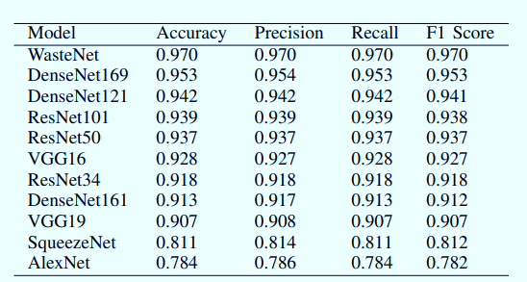
Scope and Future Enhancement
Scope
Future Enhancements To Increase Its Usability Among Its Users
Extend the scope of credit point distribution beyond parking lot facility;
Add extensions in the recycling machine to identify the recycling waste better and reduce the chance of False positive cases
Separate segregators inside recycling bin for each type of material being dumped into the same
The recycling box would show updates about what item is missing and needed most and based on same credit point distribution algorithm would be changed,
Automatic alert would be raised to the recycling waste team to pick the waste collected and empty the recycle bin as soon as possible
Generating shareable E-certificates to give users a sense of pride and make them realize how their small step is making an impact
Installing solar panels on campus is a well-established project but Use of solar panels made of plastic is not yet widely available in the market
During the program's implementation, we will continue to observe the actual effect and feedback of the plastic solar panels in the market and the current incentive policy on the campus to adjust our scope.
Focus on waste classification using video feeds in next phase
Planning to update the model and collect additional data to allow for the automatic classification of waste where objects may be overlapping
Use integrate Object-Detection networks (YOLO) for real time object labeling to have more general perspectives. Also, we can try a mix-match of the below given architectures for object detection.

Slide 18
Conclusion
The results provided interesting insights for future waste classification
The high accuracy of 93% achieved shows the potential of the methods used
The models can be readily deployed over the waste bins at parking spots. This would increase the amount of waste being recycled, while also reducing the financial burden for ASU parking facility users by generating parking credits
The method can also be applied at large scale to automatically sort waste into different categories to allow for easier recycling

Slide 19
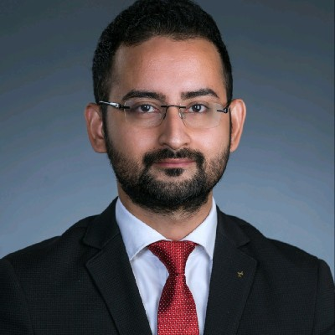



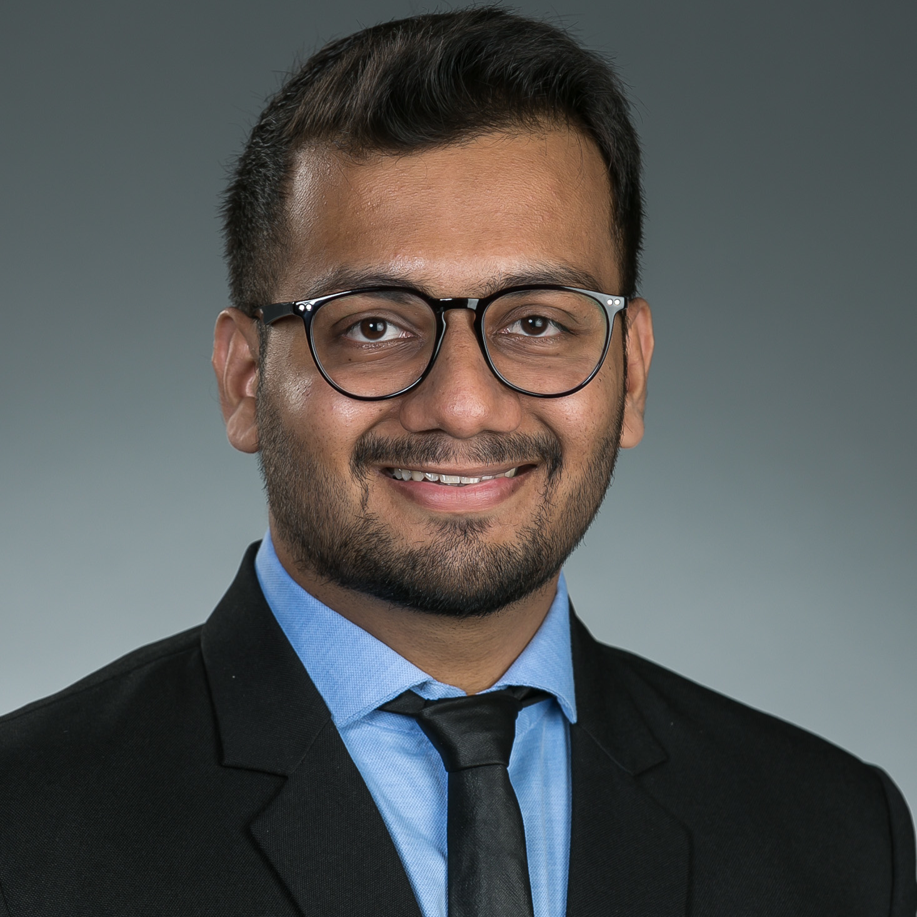
Team B11-Cohort B Thanks & Cheers - Signing off MSBA’22 !!
Anurag Bhattacharjee
Dinesh Koonamakkal
Yugantika
Jing Hao
Yash Jain

